Slide 1
Project 2 - Pokémon Data Visualization
Scott Barnett
Brittany Clemmons
Laylaa Tariq

Slide 2
Overview
Pokémon is a wildly popular multimedia franchise that launched in Japan in 1996
Pokémon is the world’s largest media franchise (valued at $59 billion in 2018)
With over 800 creatures as of late 2019, each with its own combination of attributes and stats, Pokémon is a topic well-suited for data analysis

Slide 3
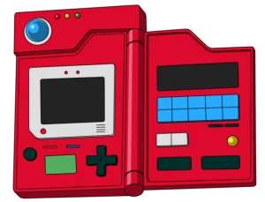
Theme
Pokémon Dashboard
Dashboard theme was inspired by the concept of the Pokédex
In the world of Pokémon, a Pokédex is a hand-held device similar to a PDA that provides Pokémon trainers information on individual Pokémon creatures that they may encounter
In their world, the Pokédex holds information for the majority of commonly found Pokémon but there can be unknowns as well

Slide 4



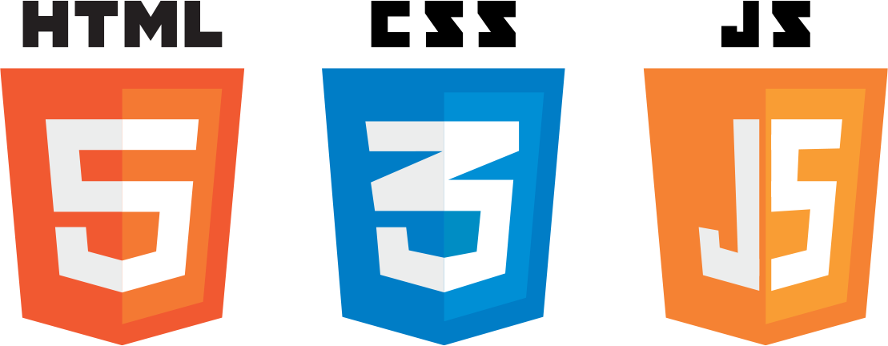


Coding Approach
PostgreSQL (database)
Python (cleaning data in Jupyter)
Bootstrap
CSS + HTML
JavaScript
D3
JSON API
Individual View
Raw Data
Chart.js
Generation Graph
Pokemon Type Graph

Slide 5
Data Munging
Two primary data sources
Data.world (initial csv)
Pokemon.com (image data)
Other peripheral information taken from Bulbapedia (bulbapedia.bulbagarden.net)
Web scraping
Pokemon.com
Data did not include images or weaknesses
Import.io
Created a recipe
Then added URLs to the crawler
Notes:
Web scraping one of the problems that took a lot of time

Slide 6
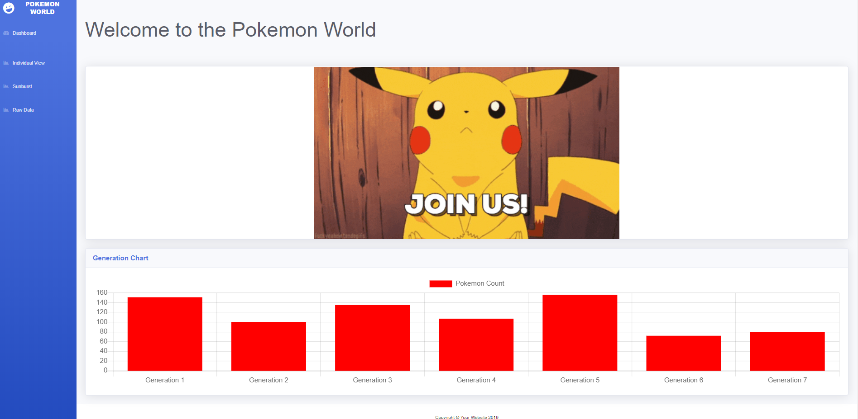
Dashboard - Home Page

Slide 7
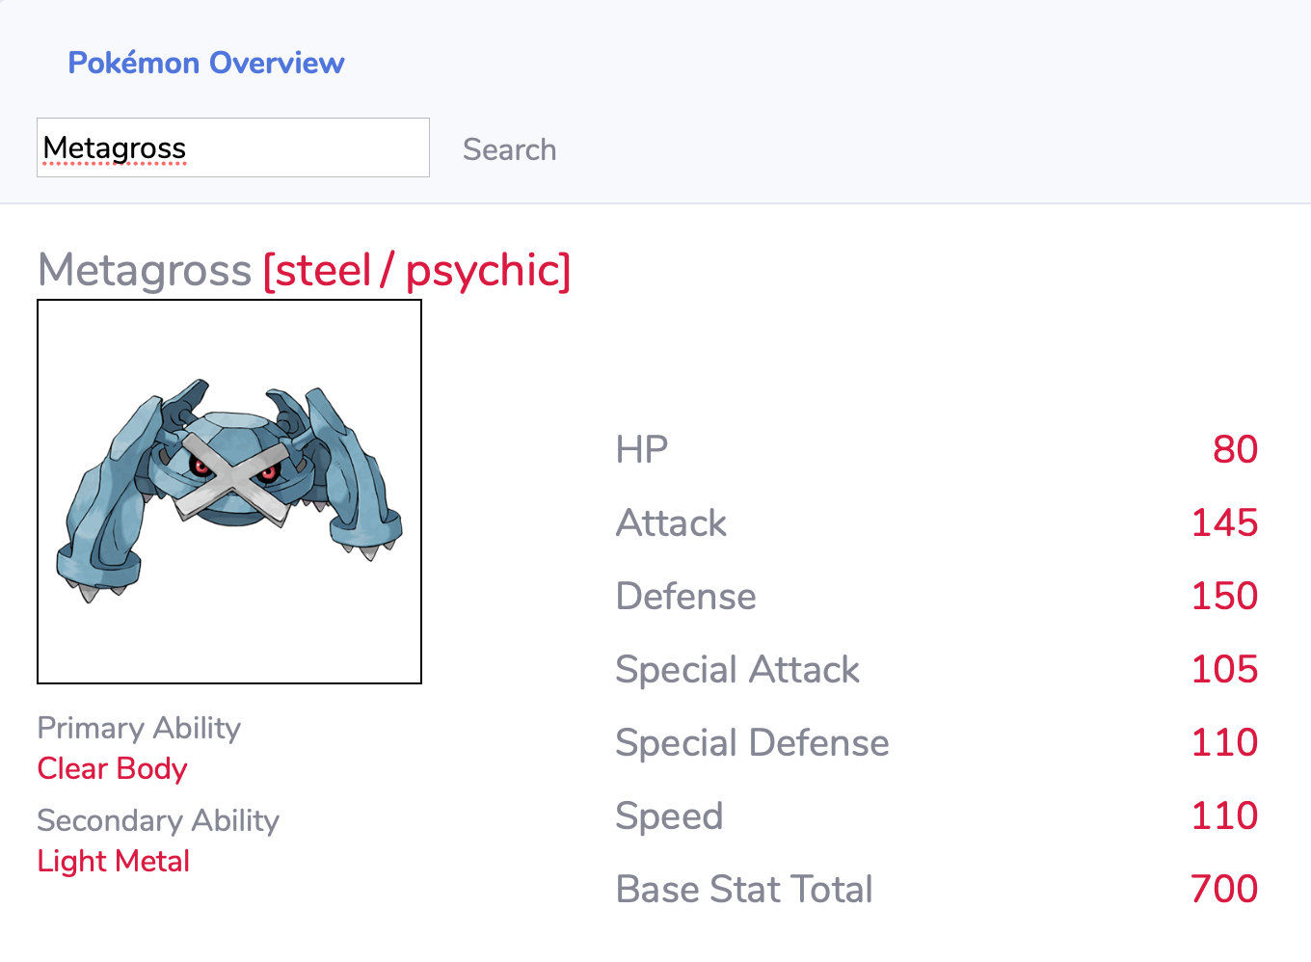
Dashboard - Individual View
Image of Pokémon scraped from pokemon.com
Name and type(s) of Pokémon
Primary and secondary abilities (if applicable)
All six base stat categories and values (as of Generation VII) and the corresponding total

Slide 8
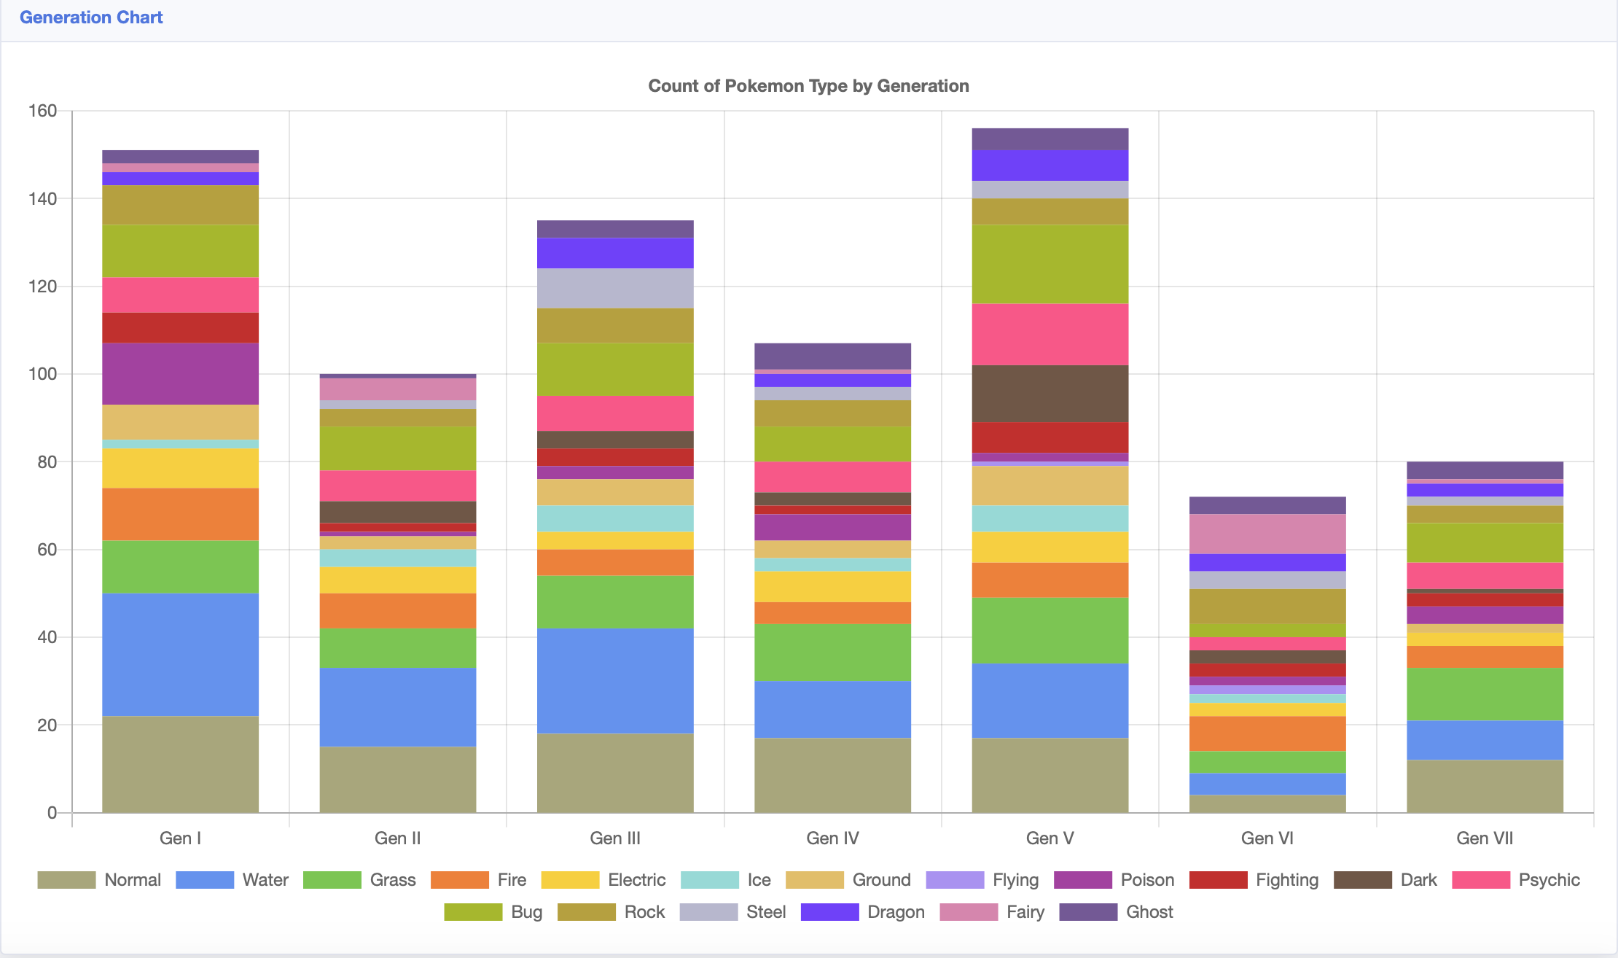
Dashboard - Type by Generation
Pokemon Type by Generation
Visualization using Chart.js
Bar Chart
Provides interactivate category selection and dynamically updates chart with selected category items

Slide 9
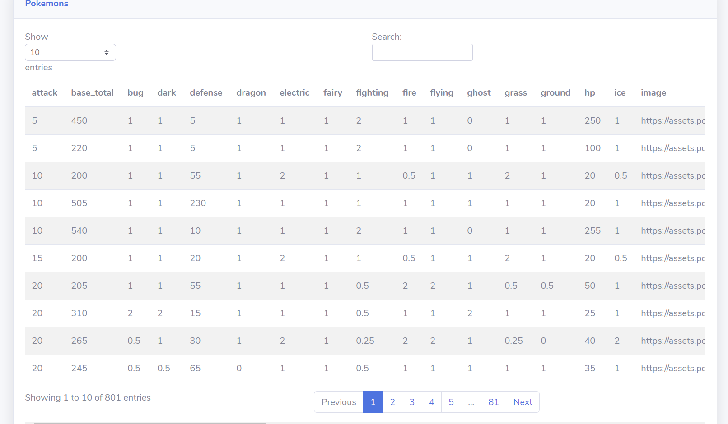
Raw Data

Slide 10
Future Directions
Interactive visuals for other stats and features (evolutions, Mega forms, movesets, breeding groups, etc.)
Interactive map visual for in-game locations and rarity
“Team-builder” comparison function was discussed, but not feasible within the allotted time

Slide 11
Questions?

Slide 12
Thank You
Scott Barnett
Brittany Clemmons
Laylaa Tariq

